Slide 1
Cascading Style Sheets.

Slide 2
What is it?
To put it bluntly it’s a set of rules the code has to follow.
You have done very similar things already an example would be changing the colour of some text.
<font color="red">This is some text!</font>
= This is some text!

Slide 3
So How is CSS Different.
Well we add some new rules.
Remember that the head holds all the knowledge and the body shows it? Its time to use your head again!
Placing this in the head will create a style called red that when used will turn text red.
<style>
#red {
color: red;
}
</style>

Slide 4
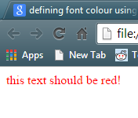
How to use it?
Now you have made your class called “red” you need to tell the code to use it.
How do we do that? With the I.D. function. E.g.
<font id="red"> this text should be red! </font>
This outputs…………..

Slide 5
But wait! That’s not all!
It seems a lot of effort to go to simply to change the font colour right?
So why use it? Because we can add more than one thing in there! Oh yeah baby!
You want to change the size? The font? If its bold or underlined? You can put it all in the same class!
font-family: "Times New Roman", Times, serif;
font-style: italic;
font-size: 14px;
These are just some of the options you could use check out W3Schools for more options!

Slide 6
So lets try it out!
Try going back to one of the webpages you have used before and making a style and calling it in where you have changed the colour of text before.

Slide 7
So is that it? No No No No No.
So as you can see using this process saves you time in writing out long lengths of code again and again.
But CSS can take this one step further.
Thinking back to last week you can see that its easy to copy and paste things into new webpages etc.
You can do this for all your styles buts its going to make your head HUGE!!! And your code messy.
Also think about if you want to change something? That’s a lot to go and edit so how do we get around this?

Slide 8
External Style Sheets!
This is a place specifically for all the styles you create and it can be applied to all pages.
Meaning you can make a change here and it will apply to every page you have linked in the style sheet. Clever huh?
So how do they look? Basically the same.
If you use dreamweaver you can tell it to make you a CSS document and you just have to define the styles in it.

Slide 9
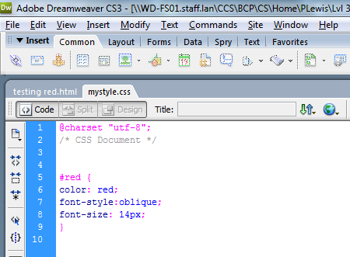
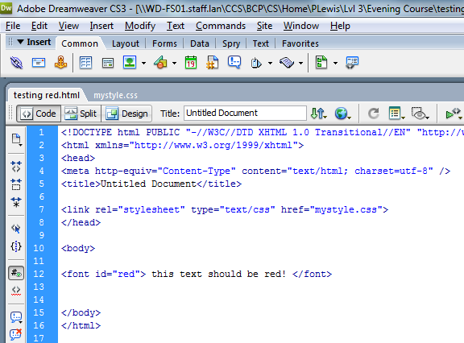
If we take the style we made earlier and place it in the style sheet like so….
Then add a line into the main code telling it where to find the CSS rules like so…..

Slide 10
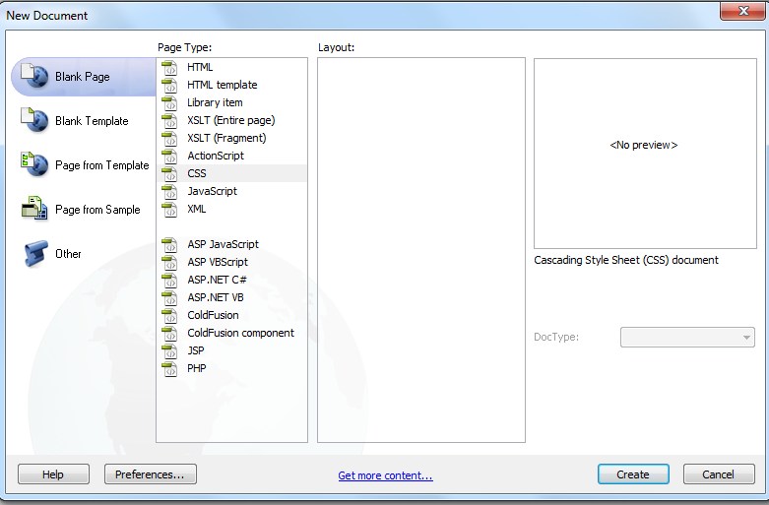
You’ll end up with the same results as before!
So guess what time to try it!
In dreamweaver click “File” then “New” and chose the CSS option.

Slide 11
When you save it call it basic
You will also need a new html file and call it
basic css.

Slide 12
Some Things to Note.
When using an external style sheet you don’t need to write <style> </style> around the styles you create.
If you are creating a style you need a # before the name in the external style sheet.
If you are adding values to a generic style e.g. <h1> you do not need the #.
I know it’s a lot to remember but it will become second nature.

Slide 13
So try that now.
Lets just change the <h1> for now and give it some colour!
Add to your external style sheet
h1 { color: blue; }
Then if you are using your old web site see what happened to the colour of your text using h1.
If you made a new one add <h1> this should be blue </h1> into your html body some where.

Slide 14
So that’s it? Never!
Thus far all we have seen with CSS is changing text and setting up some styles. Its good to have style!
But this isn't all this CSS is limited to oh no!
This concept of CSS extends on to positioning and size of elements in web pages.
So time to tackle the next step!
Brace yourselves people this will warp your minds!

Slide 15
We’ll K.I.S.S it.
Positioning is one of the hardest things to get your head around in CSS so that’ll be a lesson all to itself so to be nice I’ve given you your positioning elements.
What I want to focus on next is creating a basic page using CSS to get you away from using tables….

Slide 16
The beginning.
Right now in your basic CSS you will need to add the following elements.
so here is a nice list for you to type in.
#header {
background: blue;
width: 100%;
}
#leftcolumn {
background: red;
float: left;
width: 25%;
height: 700px;
}
#content {
background: black;
float: left;
width: 75%;
height: 700px;
}
#footer {
background: green;
clear: both;
width: 100%;
}

Slide 17
Thanks Paul!
So now you have some elements but we need to actually see what all this does.
TO THE HTML WE GO!!!
In your basic css.html page you will need to add 5 things to it to make it all work.
1 – Link in the external CSS page.
2 to 5 – 4 “div tags” to display all your hard typing.
Which look like……

Slide 18
Get typing.
In the head we need:
<link rel="stylesheet" type="text/css" href="basic.css">
In the body we need:
<div id="header">Header</div>
<div id="leftcolumn">Left Column</div>
<div id="content">Content</div>
<div id="footer">Footer</div>
Once you enter all that in save it and preview and you should end up with 4 boxes that look like something from the 1980s.

Slide 19
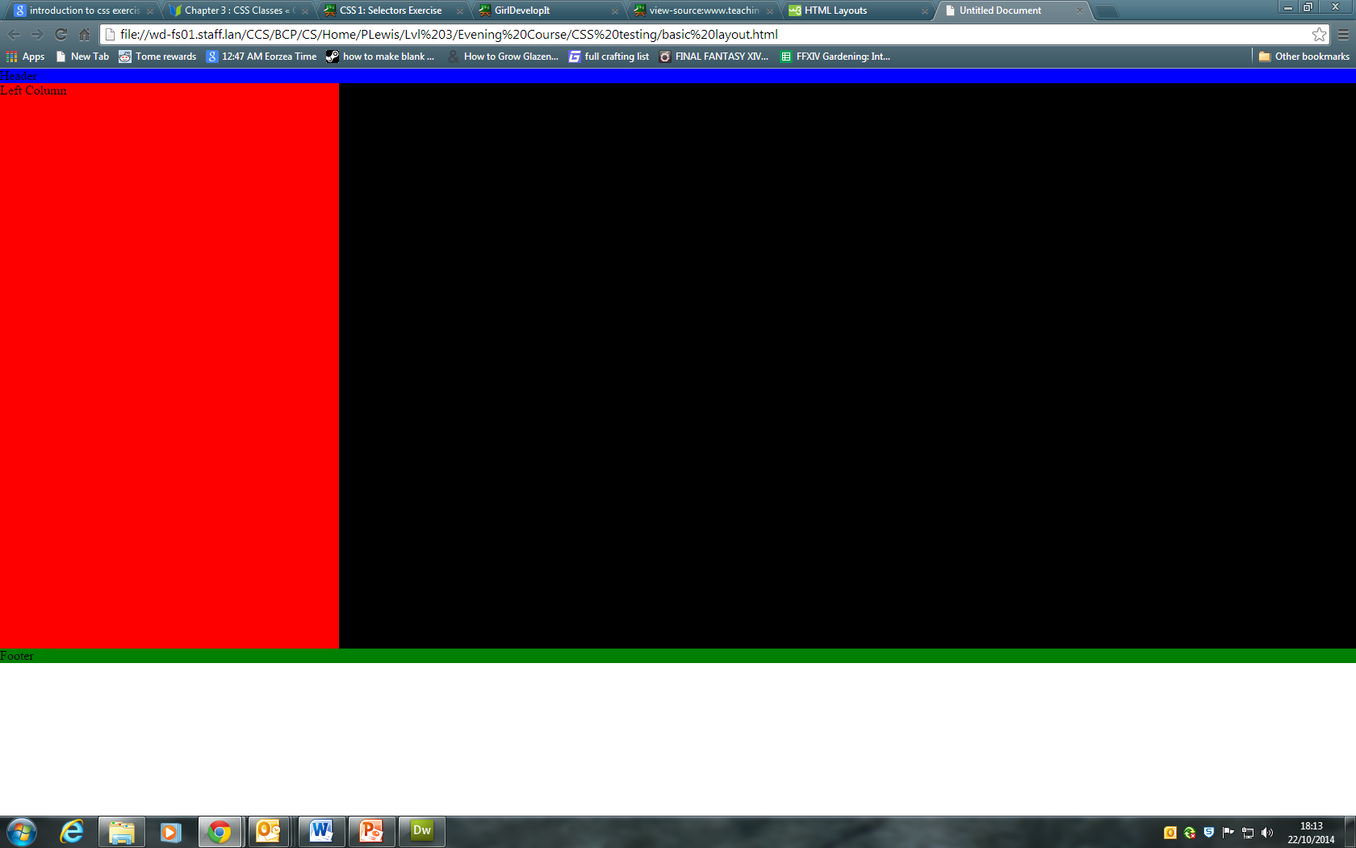
Something like this.
UGLY right?

Slide 20
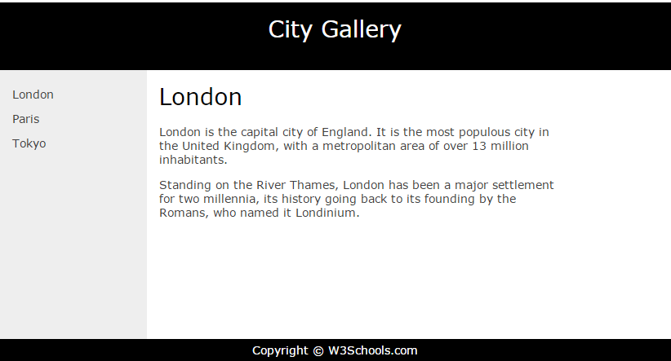
Time to make it pretty.
I want you to change it to look like this.
Notes:
http://www.w3schools.com/html/html_layout.asp

Slide 21
How to do it?
Focus on one area at a time.
Start at the head figure out what needs to change and add a rule to your div tag with which holds that content to make it look like it does in the picture.
You will need to possibly adjust some sizes this is done with width. (not too worried about this right now).
To make the navigation (on the left) you will need to adjust the html and either make a list or use <p> tags.

Slide 22
Extension Task.
In DreamWeaver go to page properties and adjust some of the link attributes.
See if you can adjust it so the colour changes and the text becomes underlined.
This should all be in the properties box.
Once you have done this see what its added to the HTML in the head.
Now attempt to move that code to your external CSS page and make it work.

